Slide 1
DECISION TREE
with Python Scikit-Learn
February 2023

Slide 2
Review
TRAINING THE MODEL
TRAINING SET
MODEL
(UNTRAINED)
FEATURES
LABELS
PARAMETERS

Slide 3

Training The Model (Decision Tree)
Import the model from a package (sklearn)
Create an instance of the model
Train the model (often using the fit() function)
…

Slide 4
DECISION TREE
GENERATE TREE
MODEL
(TRAINED)

Slide 5

Generate Tree
Decision Tree Visualization:
Trees from trained Decision Tree models can be extracted
export_text(model, feature_names=features_list)
Output: string representing the tree

Slide 6
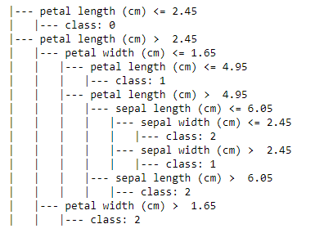
Generate Tree
Decision Tree Visualization:

Slide 7

Generate Tree
Decision Tree Visualization:
Can be plotted as well using matplotlib

Slide 8
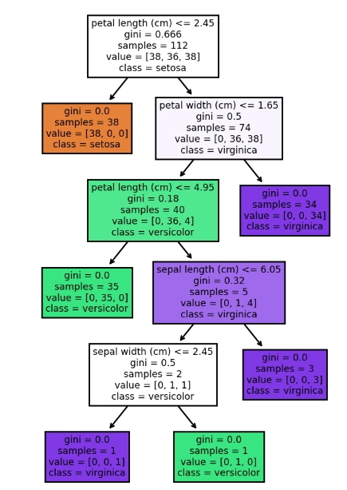
Generate Tree
Decision Tree Visualization:
Can be plotted as well using matplotlib

Slide 9
Overview
REDUCING FEATURES
FEATURES
LABELS
FEATURES
LABELS

Slide 10
Reducing Features
Remove Columns
We can remove column/s and use the new dataframe to train a new decision tree model and compare trees they generate
FEATURES
FEATURES

Slide 11
Reducing Features
Remove Columns
Insert list of feature names that will be included in the new dataframe as demonstrated below:

Slide 12
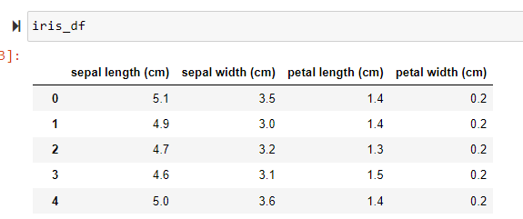
Reducing Features
Original Iris Dataframe Features:

Slide 13
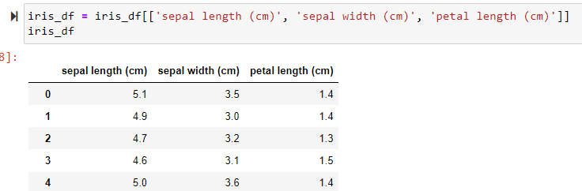
Reducing Features
New Iris Dataframe Features:

Slide 14
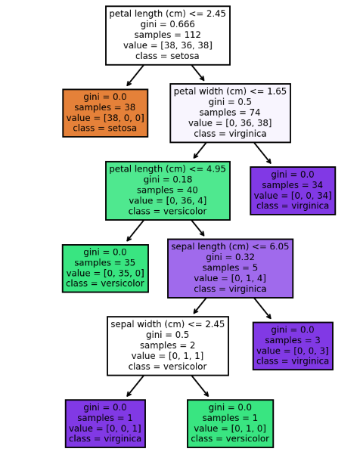
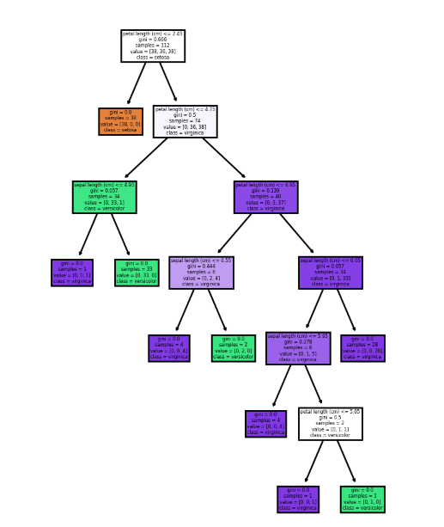
Reducing Features
ORIGINAL TREE
NEW TREE

